Slide 1


SHIELD INSURANCE pilot project
Faraz Ahmed
Virtual Internship CodeBasics Bootcamp

Slide 2
Shield Insurance is an insurance company providing life insurance to its customers.
Shield Insurance is potential customer of CodeBasics and for trial has assigned a pilot project to be completed.
As per customer’s requirement and subsequent discussion initially Shield Insurance provided their basic requirements along with data of 6 months i.e. from November, 2022 till April, 2023.
As per the data provided company's network is spread to five cities namely Chennai, Delhi NCR, Hyderabad, Indore & Mumbai.
They are offering 9 types of insurance policies.
They sale through four different channels i.e. sales mode namely offline agents, offline direct, online app & online website.
We prepared a mockup of the dashboard which was shared with the company and in reply they provided a mockup with few changes.

Slide 3
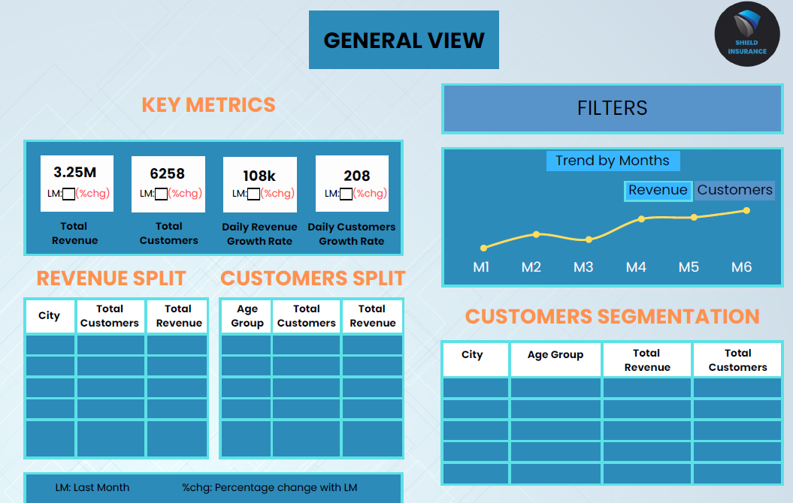

Slide 4
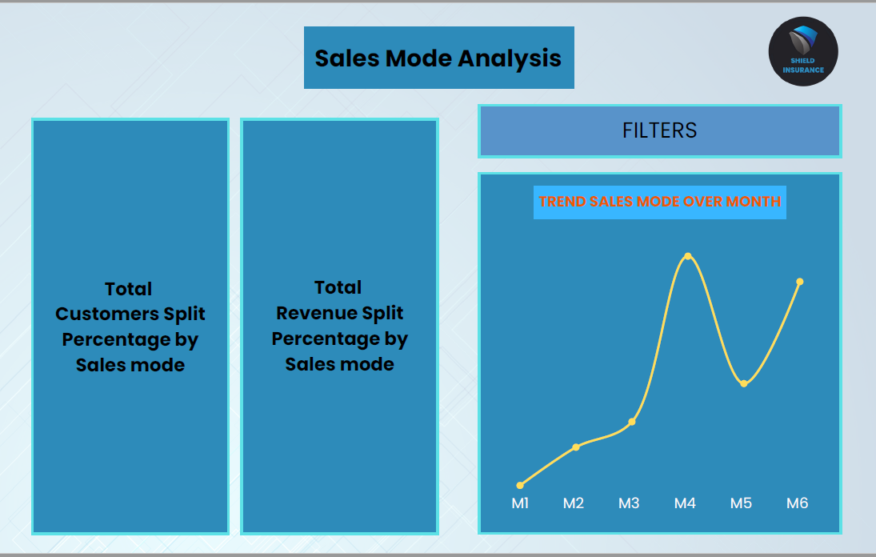

Slide 5
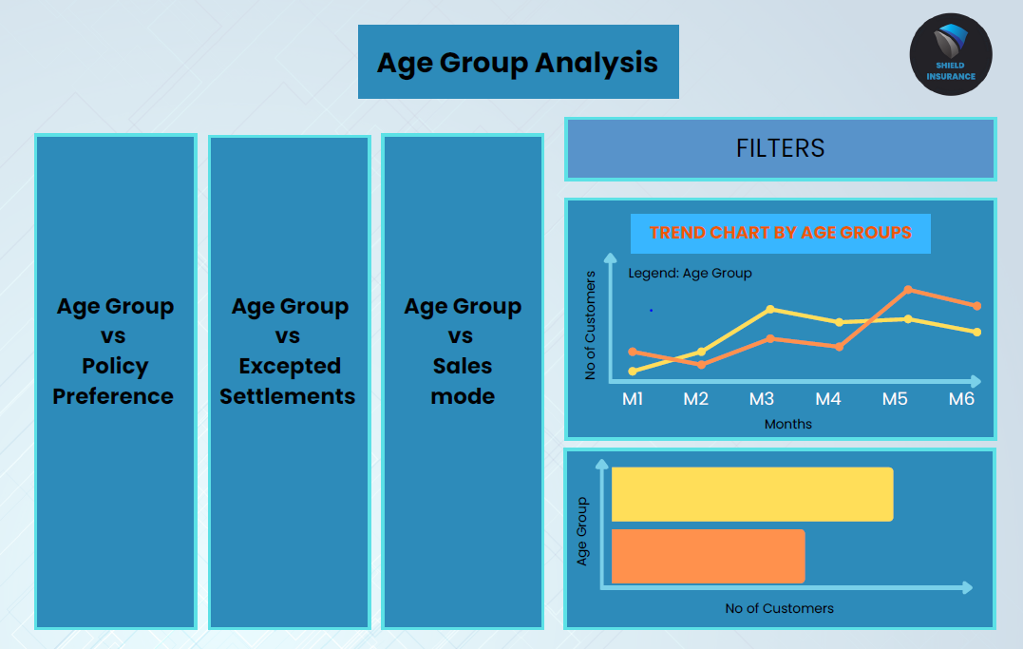

Slide 6
OBSERVATIONS:
Company posted revenues of INR 989.25M and customer count of 26841.
Delhi NCR has the highest share in terms of revenues & customers while Indore has the lowest share.
In the month of March, 2023, the revenues and customers witnessed huge increase of over 80% in revenues and customers as compared to previous months as well as upcoming month of April, 2023.
Due to huge increase in March the KPI for the month of April, 2023 shows huge dip in revenues as well as customers.
Offline Agent is the most successful sales mode as it share is more than 55%.
The age group of 31-40 has the highest number of customers as well as revenues.
The age group of 65+ has the lowest number of customers while age group of 18-24 is lowest in terms of revenues.
The expected settlement is directly proportional with age group i.e. 65+ has highest expected settlement rate of 74% which reduces to 38% for the age group of 18-24.
The type of policies shows indirect relation between revenues and customers as Policy ID # POL4321HEL has highest number of customers but lowest in terms of revenues.
Whereas Policy ID # POL2005HEL & Policy ID # POL1048HEL earning the highest revenues i.e. more than 50% of total revenues have the lowest number of customers.

Slide 7
RECOMMENDATIONS:
Company must concentrate on increasing customers as well as revenues in cities with low volume particularly Indore, Chennai & Hyderabad.
The offline agent has a volume of over 50% but online options i.e. app & website have also grown significantly and Company must target to increase online sales.
The company should emphasis in increasing the share of age group of 31-50 as the under 30 have low premium amount, whereas, above 50 has high probability of expected settlement. But age group of 31-50 has a balance in terms of revenues as well as expected settlement.
The company shall focus on increasing the volume of highest earning policies i.e. Policy ID # POL2005HEL & Policy ID # POL1048HEL.

Slide 8
Thank You!
Faraz Ahmed
Virtual Internship CodeBasics Bootcamp

